Slide 1

Abstract Syntax
Sept 2016

Slide 2
Abstract Syntax*
An Abstract Syntax Language is:
a formal language for specifying the logical structure of data that is to be exchanged between two endpoints
independent of hardware platform, operating system, programming language, local representation, etc.
standard sets of rules for encoding instances of logical data structures that are specified in abstract notation
for the purpose of transmission
* Description and Principles by Allesandro Trigila
http://www.ieee802.org/802_tutorials/2010-11/
Describes ASN.1, but applies to any abstract syntax language

Slide 3
Principles and Benefits*
Separation of concerns
The description of the logical structure of a message is kept completely separate from the details of the encoding
Message descriptions are machine-processable
This enables the creation and use of software development tools and testing tools that can read and understand the formal definitions
Encodings are standardized
The problem of specifying detailed encodings and the problem of encoding/decoding messages and their fields do not need to be addressed again and again
Extensibility
It is possible to extend a message description in controlled ways while ensuring backward- and forward-compatibility between different version implementations

Slide 4
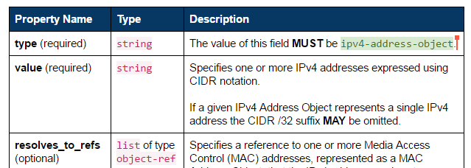
OASIS CTI Data Definitions
STIX, TAXII, CybOX are specified by Property Tables
Abstract description of data objects
Independent of serialization (XML, JSON, binary)
Not a formal notation
Table cell contents follow conventions, but …
Free-form text, cannot be machine parsed, validated, or translated
Interim step toward formal abstract specifications?
Would enable automated translation to concrete schemas:
XSD
JSON Schema
Proto3
…

Slide 5
OpenC2 Data Definitions
Current: Python abstract data structures
Executable: enables encoding- independent message validation
Define OpenC2 abstract syntax
Unambiguous type checking
Validate example messages
Support multiple message formats
Verbose JSON
Concise JSON
Minimized JSON
Corresponds to non-executable property tables and abstract syntax language
class OpenC2Command(Record): vals = [ ('action', Action, ''), ('target', Target, ''), ('actuator', Actuator, '?'), ('modifiers', Modifiers, '?')]
class Action(Enumerated):
vals = [
'scan', # 1
'locate', # 2
'query', # 3
...
‘remediate‘] # 35
class Target(Record):
vals = [
('type', TargetTypeValue , ''),
('specifiers', cybox.CyboxObject,
'?,{type}')]

Slide 6
OpenC2 Data Definitions (cont.)
Vision: Abstract Syntax Language
Technology pathfinder for CTI suite
OpenC2 demonstrates feasibility, others may follow

